Slide 1
Capstone Presentation
High-Res Irrigation Detection
Weixin Wu, Matt Brimmer, Sonal Thakkar, Will Hawkins, Adam Sohn

Slide 2
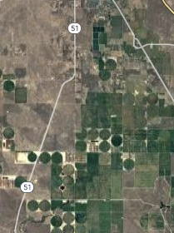
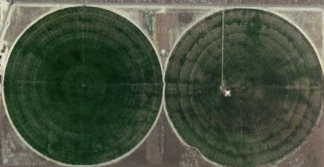
Background & Project Objective
Low Resolution
Each Quadrant: ~8km^2
Key applications
Public Policy → Ensure sustainable water usage
Water Rights → Pricing irrigated water
Food Security
Climate and Weather
Current Irrigation Data
Out-of-date
Unreliable
Low resolution
High resolution → optimal policy creation and monitoring
High Resolution (30m)
Objective: To create a tool to generate high-resolution irrigation maps and datasets.
Notes:
MATT [1:15] // now 1:40 [1:23s]
Welcome everyone -- we’re the Hi-Resolution Irrigation Detection Team!
We have been very fortunate this term to work directly with the world-class environmental science department at Berkeley, specifically professor Paolo D'Odorico, Drs. Lorenzo Rosa, and Manuela Girotto (Gee-Roto) to help us with this globally-impactful project.
Our aim is to push the frontier of knowledge of global irrigation. This is important for a number of applications..
For example,
From a public policy standpoint, irrigation data can help with monitoring and ensuring sustainable water usage
The data can also be used to determine water rights laws for things like properly valuing the price of water
Additionally, irrigation can impact weather, precipitation, and temperature, and can have an impact on climate change
The current data on irrigation has issues. The source of truth (coming primarily from data captured sporadically by countries) is out of date, unreliable, and at a lower resolution than what researchers would like.
Our objective with this project is to create a tool to generate very high resolution maps on what is irrigated / not irrigated.
*CLICK*
To get a feel for the resolution, the image at the top (red quadrants) is roughly the resolution available today.
*CLICK*
What we have developed is shown within the yellow breakout - the purple boxes are roughly our output resolution (30m).
At this higher resolution, researchers can start to be more precise about their understanding of the nature of the problem and create and track solutions.
Next slide

Slide 3

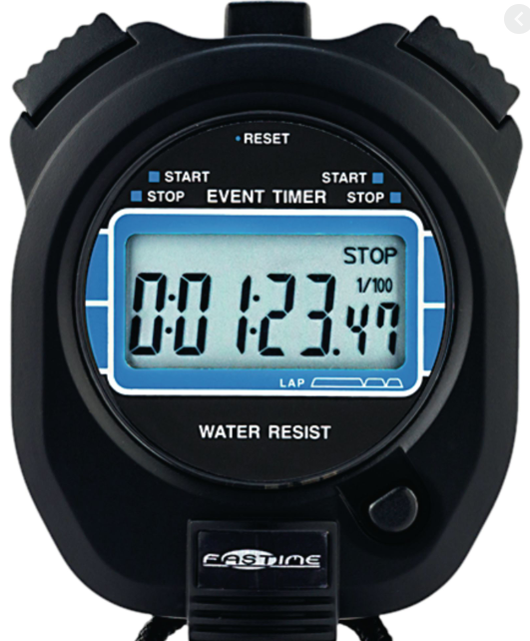
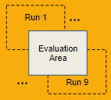
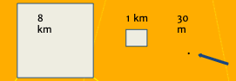
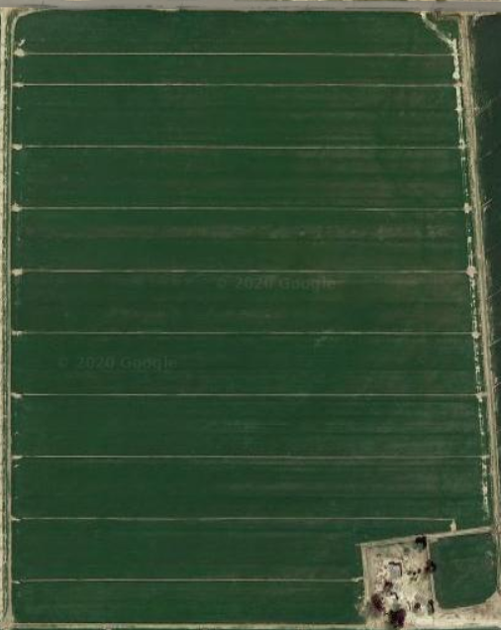
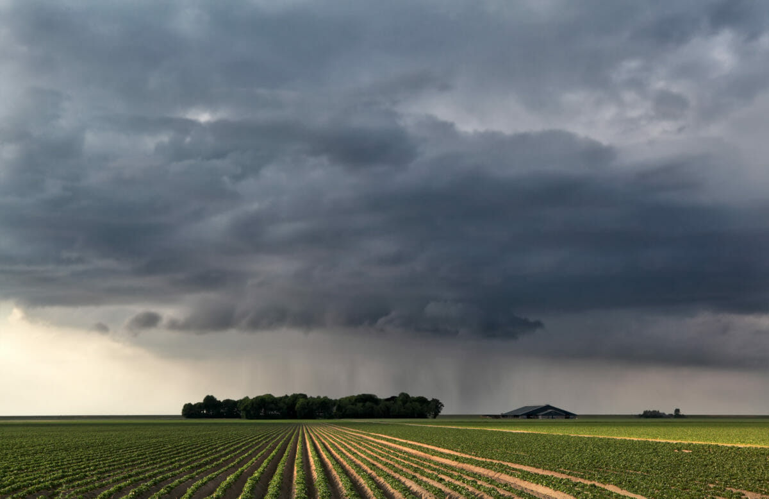
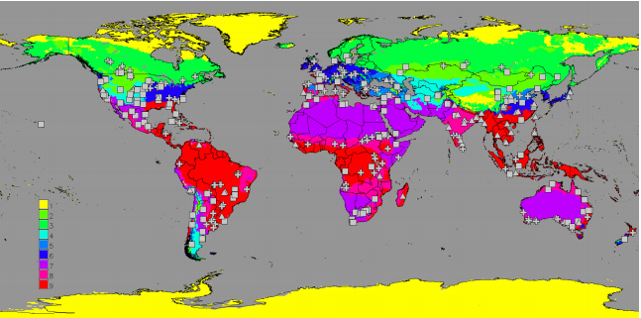
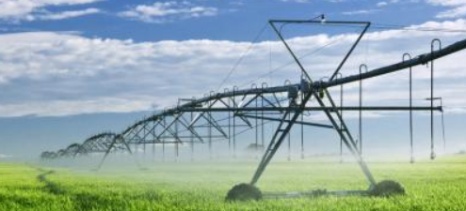
Challenges Shaping Irrigation30
Challenge | Solution
Compute Complexity Global inference @ 30m resolution is runtime of 16 years | Python Package: Small region inference
Source-of-Truth
No global dataset @ 30m
for supervised ML
Unsupervised ML,
Expert User Study, Custom Eval Metrics
Temporal Signatures
Geolocation, weather,
crop types, crop seasons,
irrigation types
Leverage correlations and heuristics
for label and cluster prediction
Rain
… or
Irrigation
Notes:
ADAM [1:00]
Our objectives shape our goals and our challenges shape our approach.
To extend the work of others, yet set resolution at 30m, inference runtime would be 16 years. Our solution is to deliver a high resolution real-time inference on a small area.
**click**
To run supervised ML algorithms, source of truth is required. This exists at 8 km and 1km, yet there is nothing authoritative globally at 30m. Our solution is to run unsupervised learning and use creative evaluation methods.
**click**
Temporal signatures in agriculture can confound irrigation determination. Our solution is to selectively leverage features that are low-collinearity and high-correlation to crop health. Domain knowledge heuristics will aid further categorization.

Slide 4
Key Datasets
Sentinel-2
Spatial resolution of 10 m, 20 m and 60 m
13 bands in the visible, near infrared, and short wave infrared spectrum
VI Index bands: blue (B2), green (B3), red (B4) and near infrared (B8)
TerraClimate
Monthly climate data for global terrestrial surfaces at 4.2km resolution
GFSAD30
30m scale cropland data for pixel data pulls for croplands
GFSAD1000
1km scale cropland data for random pixel sampling
Notes:
Sonal[45 sec]:
In order to obtain 30m scale resolution we have leveraged Sentinel-2 dataset. These images are obtained from ESA (European Space Agency) satellites that collect high-resolution multispectral imagery
//Lets us list the datasets we have explored: Modis, Landsat7 and Sentinel-2
//We finalized on using Sentinel 2 data since these are high-resolution images needed for scale level 30m.
Earth observation satellites acquires digital images in a small spectral band. The bands are grouped into wavelength regions based among other things on the origin of the light.
We used TerraClimate dataset for monthly climate data. Since temporal signatures behave very differently across the globe. For eg. Jan can be farming season for India but is ice cold in Idaho. So we want other climate information to help with building the ML models.
GFSAD30 helps identify cropland at 30m resolution.
GFSAD1000 has irrigation labels at 1000m resolution.
And we access all these datasets through single sign-on provided by Google Earth Engine

Slide 5
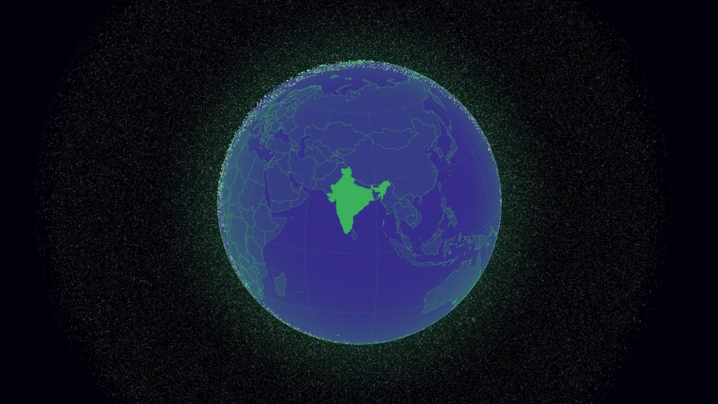
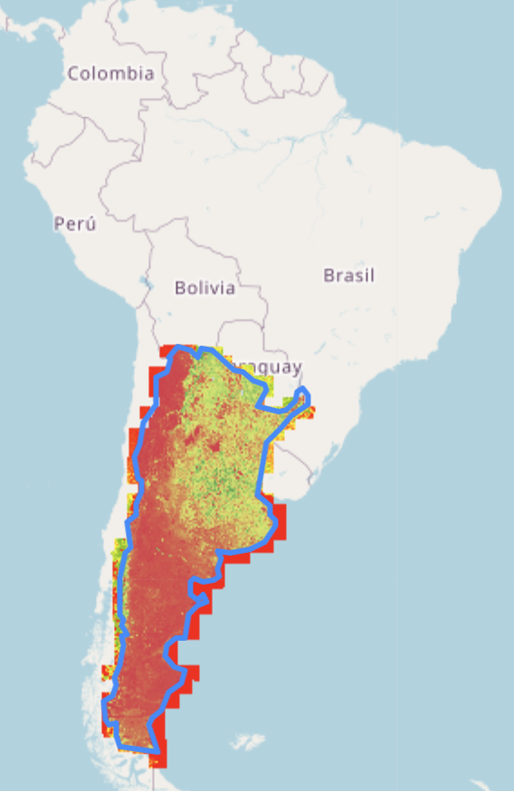
GEE Data Limits and Compute Constraints
GEE Limit:
Maximum one-time pull of 5000 images
Map rendering with folium limit 5000 overlays
Maximum one-time download of 10 million pixels
10 km² = 111,111 pixels (30m)
Argentina
Size: 2.78 million km²
Time Period: 1 month
#Images: 3421
Time Period: 2 months
#Images: 7043
Notes:
Sonal [36sec]:
However it is not easy to compute data at the high-resolution we need for the project.
There are multiple limits we face when trying to download data at 30m scale. GEE limits of 5k images per pull.
folium not allowing rendering of images with over 5k overlays and read limits per minute.
For example as we can see downloading the pixel level data for say Argentina would be near impossible given the time and compute limits. Collecting the images beyond a month at 30m scale hits the GEE limits. And if we try to read NDVI information for this area even for a day we face computation errors due to pixel read limit.
: EEException: Computation timed out.
for 1 day (76 billion pixels):
Total number of images in the collection: 21
/usr/local/lib/python3.6/dist-packages/ipykernel_launcher.py:25: UserWarning: Multiple tiles are selected. Proceed with caution.
Number of tiles selected: 21
/usr/local/lib/python3.6/dist-packages/ipykernel_launcher.py:131: UserWarning: There are null values in the output DataFrame. Proceed with caution.
---------------------------------------------------------------------------
HttpError Traceback (most recent call last)
/usr/local/lib/python3.6/dist-packages/ee/data.py in _execute_cloud_call(call, num_retries)
344 try:
--> 345 return call.execute(num_retries=num_retries)
346 except googleapiclient.errors.HttpError as e:
6 frames
HttpError: <HttpError 400 when requesting https://earthengine.googleapis.com/v1alpha/projects/earthengine-legacy/value:compute?prettyPrint=false&alt=json returned "Image.reduceRegion: Too many pixels in the region. Found 76199918784, but maxPixels allows only 10000000.
Ensure that you are not aggregating at a higher resolution than you intended; that is a frequent cause of this error. If not, then you may set the 'maxPixels' argument to a limit suitable for your computation; set 'bestEffort' to true to aggregate at whatever scale results in 'maxPixels' total pixels; or both.">

Slide 6
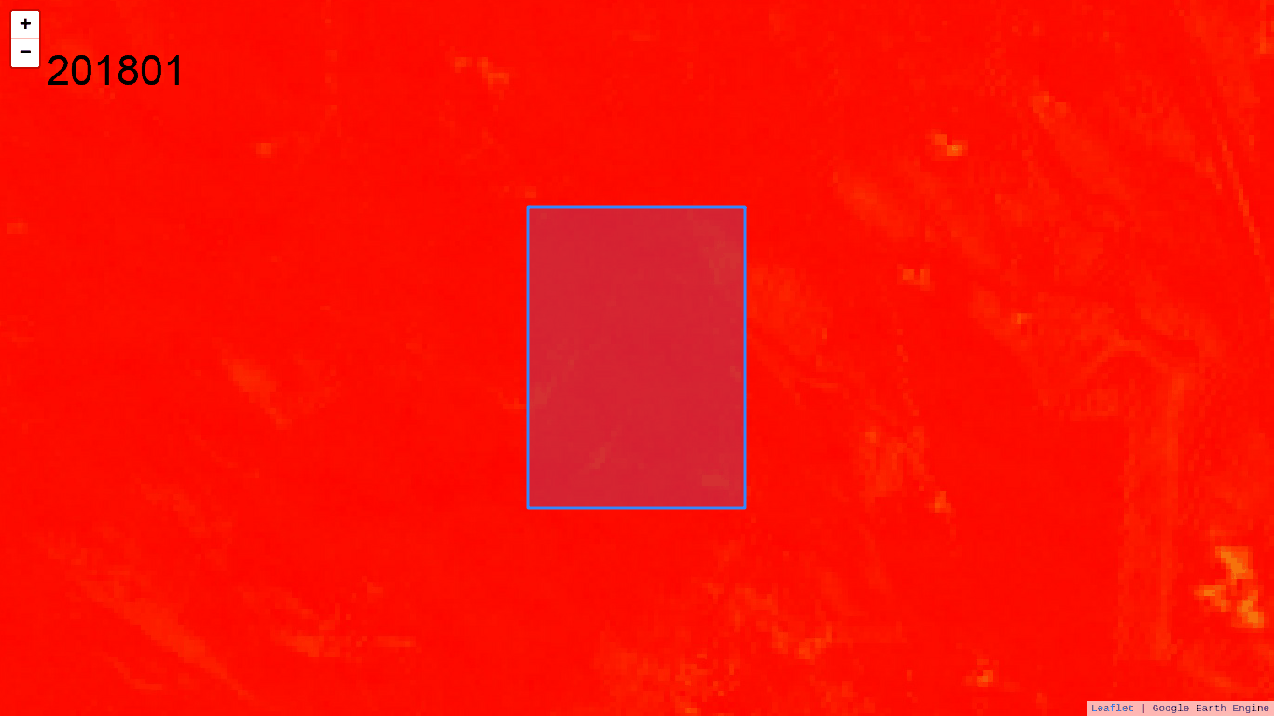
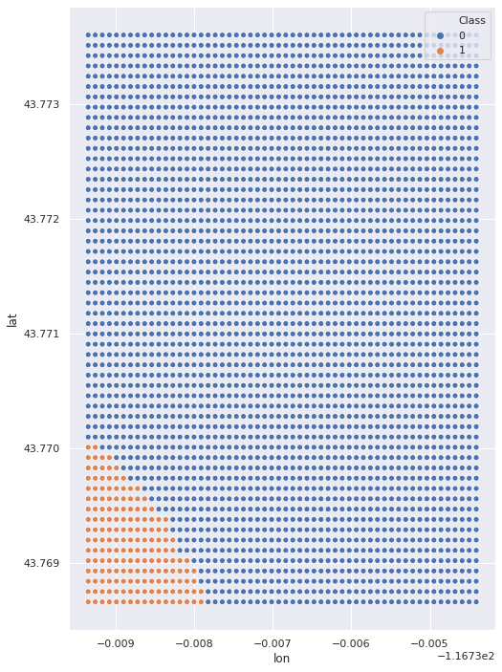
Irrigation Prediction using Temporal Signature
Notes:
Sonal [24 sec]:
In order to use unsupervised learning we utilize vegetation index for classifying clusters.
Human eye cannot visually perceive NDVI or near-infrared as is. So we use a calculation based on the band readings to determine VI indexes across geographies and time periods which is then fed as a dataframe into models.
Based on EDA, we found that clustering is effective in identifying areas with different NDVI signatures.

Slide 7
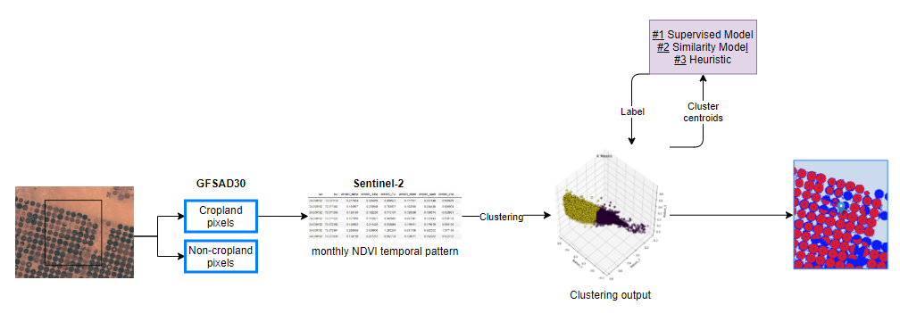
Modeling Pipeline
Notes:
Angela [50-70s]
Here is our modeling pipeline for an area of interest. We made a simplifying assumption that only cropland can be irrigated and non-cropland cannot be irrigated. This assumption aligns with the project motivation of understanding global agricultural irrigation. Although someone’s lawn may be irrigated, it’s not the focal point of this project. So the first step of the pipeline is to weed out non-cropland pixels and pull monthly vegetation index on the remaining cropland pixels.
Based on our EDA as Sonal mentioned, we learned that unsupervised clustering algorithms can be effective in separating different groups of NDVI patterns in a localized area. What unsupervised clustering algorithm doesn’t tell us is which of the clusters is irrigated, if any. So we need to apply some algorithm to figure out the cluster label. The algorithm will take cluster centroids as an input and spit out a label for each cluster.
We tried three different algorithms to determine the cluster labels, and we will talk more about them in the next two slides. Our final output is an interactive map where each cluster is colored differently with a label of either irrigated or rainfed.

Slide 8
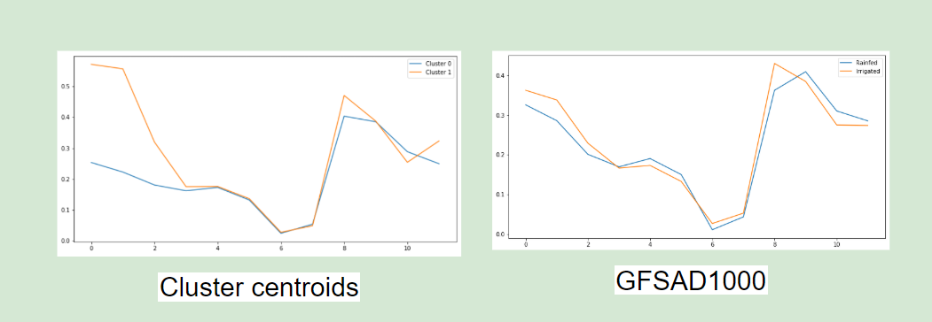
Cluster Label Determination Attempts
Approach 1: Supervised Learning Models
Global samples
Features: monthly vegetation index + climate attributes
Target: Irrigation label at 1000 m (GFSAD1000)
Conclusion: bad for local prediction
Approach 2: Similarity Model
Conclusion: GFSAD1000 shows similar NDVI temporal signatures for irrigated and rainfed croplands
Notes:
Angela [45-60s]
I will first briefly talk about our first two attempts at determining cluster labels.
We built multiple supervised learning models on a global sample of data using monthly NDVI data as well as various monthly climate data. Our target label is GFSAD1000, which provides irrigation label at 1000 m resolution. The best validation accuracy we got was 71%. Because the vast majority of features going into the model were climate attributes, which are very similar for all pixels in a small localized area, the supervised learning model was not able to distinguish between clusters in a small region.
Our second attempt was to calculate the similarities between each cluster centroid and the expected irrigation NDVI temporal pattern based on GFSAD1000. The issue we found is that, in a lot of the test cases, there was virtually no difference in NDVI temporal signatures between irrigated and rainfed croplands in GFSAD1000. As a result the similarity model did not perform well.

Slide 9
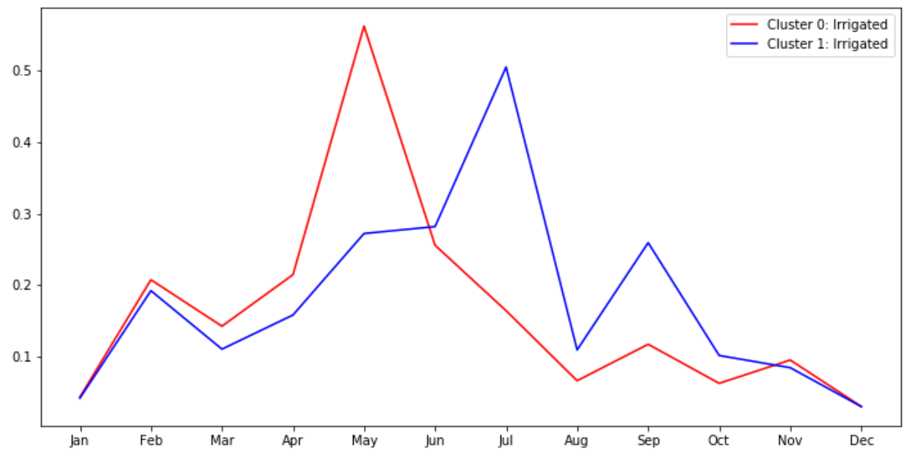
Final Model - Heuristics
Irrigated if:
NDVI > 0.3
Precipitation during the crop season < Water need
Advantages:
Can be applied to any number of clusters independently
Estimate # of crop seasons and the months of irrigation
Easy to incorporate enhancements
Notes:
Angela [55s]
Our final model is the heuristic approach. We identify crop seasons based on NDVI peaks. The crop season is considered irrigated if it satisfies two criteria. First, its NDVI peak is greater than 0.3. Second, the precipitation during the crop growing season is less than its water need. We came up with the NDVI threshold and water need estimation based on various research.
There are a number of advantages to this approach: (a) This heuristic approach can be applied to any number of clusters independently. So it’s scalable just like the clustering model (b) We are also able to estimate the number of crop seasons in a year and the months of irrigation. (c) Last but not least, it’s easy to incorporate additional research on NDVI threshold, water need by crop type, and the length of growing season by crop type.

Slide 10
Model Evaluation Framework
Expert User Study
Goal: Conduct interviews with researchers for feedback on model results and package design
Case Study: Geo-Diverse Crowdsourced
Goal: - Compare our model predictions with more croplands.org data points from a diverse range of geolocations
Case Study: GFSAD30+
Goal: - Compare our model predictions against GFSAD30’s Irrigation data in Australia and India - Use croplands.org crowdsourced data as source-of-truth
Model Consistency
Metric
Goal: - Evaluate consistency of model prediction using slight shifts in region inputs
Run 1
Evaluation Area
Run 9
Notes:
Will [1:00] [1:08 timed]
As we’ve alluded to, there is no easily accessible source-of-truth of irrigation at 30m resolution, so we had to be more creative with our model evaluation methodology. To help us evaluate our model’s performance, we pursued four different approaches.
First: We conducted an expert user study with two UC Berkeley environmental science researchers and professors-- Lorenzo Rosa and Manuela Girotto-- who gave us some positive feedback about our model results and package design.
Second: We made use of a crowdsourced irrigation dataset from Croplands.org to compare our model predictions against, and selected points from a geo-diverse sample around the globe.
Third: We compared our model’s irrigation predictions against a few cases from GFSAD30’s Irrigation dataset in India and Australia. For this, we also used the Croplands.org crowdsourced data to act as the source of truth to compare our model’s accuracy against GFSAD30’s.
Fourth: We’ve created a custom metric to evaluate the consistency of our model’s output. We test consistency for a given input region by creating 9 new phase-shifted input regions. Of the points that overlap with these slightly shifted regions, we test how often our model makes the same irrigation predictions.

Slide 11
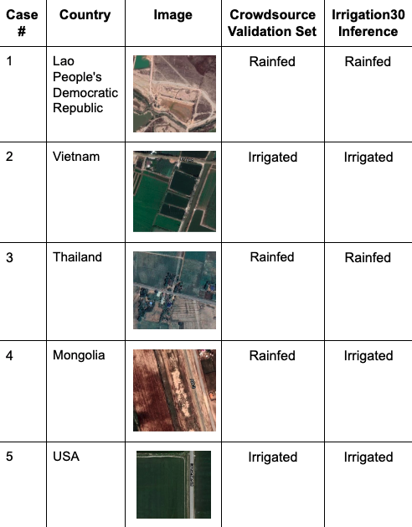
Model Evaluation: Geo-Diverse Crowdsourced Data
25 diverse coordinates from croplands.org crowdsourced dataset
Result: Irrigation30 was correct 23-of-25 compared to Crowdsource.
Be mindful of small sample size (N=25)
Notes:
Will [0:30] [0:23 timed]
For the case study with crowdsourced irrigation data, we sampled 25 points from this dataset to compare our model’s predictions against. We made sure that the coordinates we sampled were from a diverse range of geolocations and countries. The results of this case study were very promising, as our model correctly predicted the irrigation status of 23 out of 25 coordinates. This result is great, although we must keep in mind the small sample size of this case study.

Slide 12
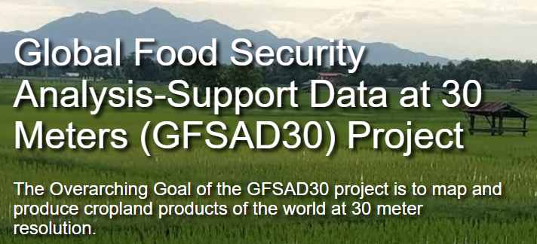
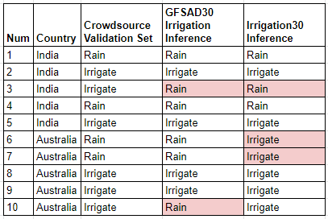
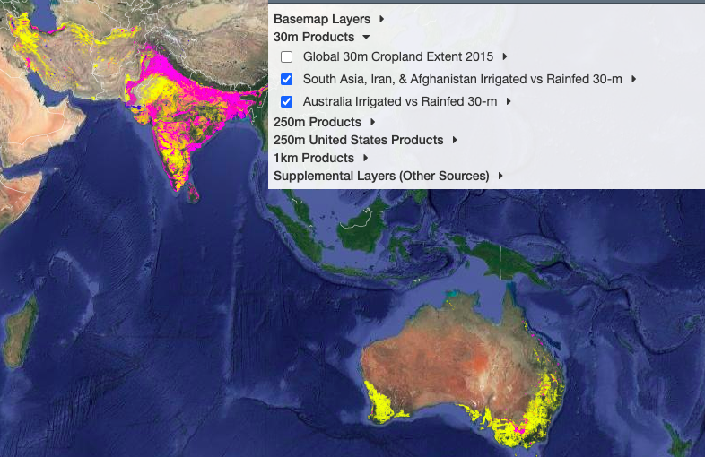
Model Evaluation: GFSAD30+ in Aus/India
Compared 10 samples of Irrigation30 to:
GFSAD30 Irrigation (India, Australia only)
Crowdsource labels
Total
8/10
7/10*
* with known Aus precipitation data issues
Based on limited sample size (N=10), there is no basis to conclude Irrigation30 performs differently than GFSAD30 (NASA funded)
Notes:
MATT [0:30]
The next course of evaluation is 10 select localized points for which we have both a crowd-sourced label and a 30 meter GFSAD label. This gives us the information we need to evaluate our model (far right column) relative to the GFSAD model (2nd from the right).
Despite known precipitation data issues in this region that we believe are causing misclassification, we accurately classify 7 of the 10 points vs the 8 of 10 from GFSAD.
Honestly, with such small sample size, we aren’t hanging our hats on any accuracy figure, but taken in conjunction with the prior slide, we feel pretty good about the performance of the model.
NEXT SLIDE
////The key takeaway is less the number (because our sample size is 10), but more the fact that our model (irrigation30) really is performing right on par with what we would feel is a good baseline. The model ‘error’ that we do have is due to the static heuristic limits. This is a known limitation of the techniques we have chosen, but areas of potential future research.

Slide 13
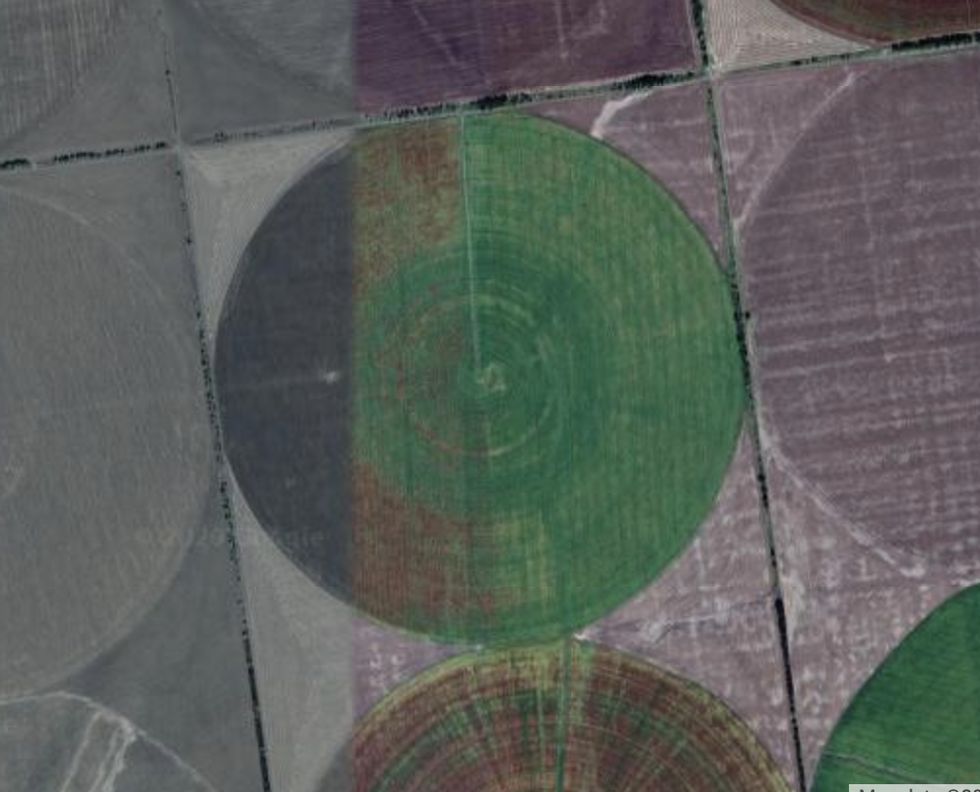
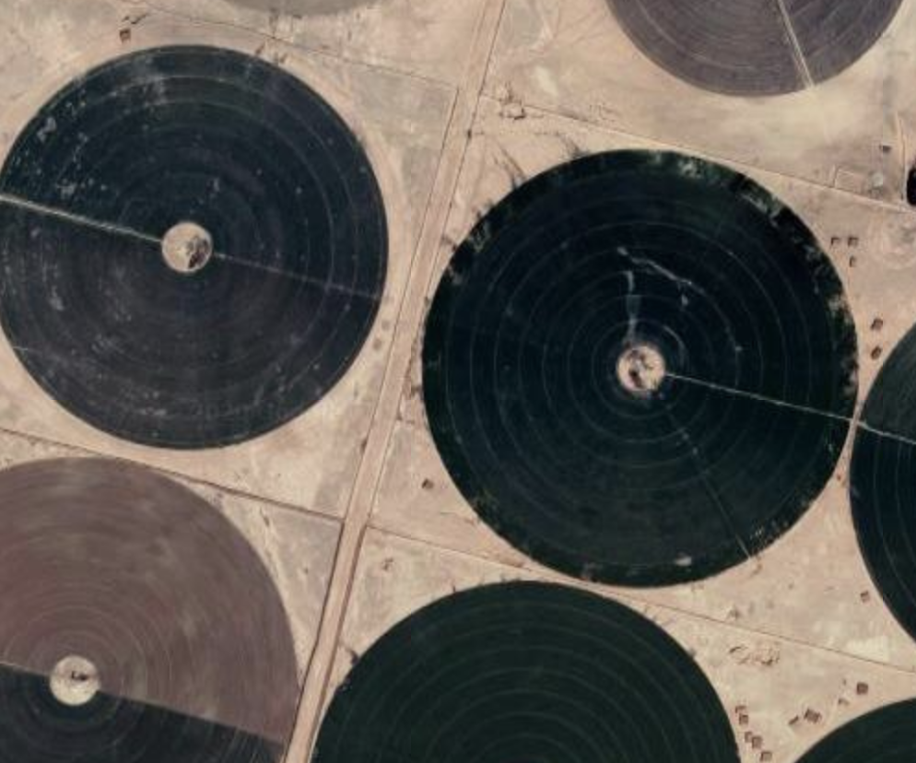
Model Evaluation: Consistency Overlap Metric
Methodology: For each point, run model on overlapping region grid and observe model consistency
Case #, Location | Consistency
1, India | 92.4%
2, Canada | 100%
3, USA (Idaho) | 100%
4, Germany | 100%
5, Germany | 99.9%
6, Ukraine | 94.3%
7, Ukraine | 95.9%
8, Saudi Arabia | 89.4%
9, Argentina | 100%
10, Uzbekistan | 96.2%
11, Brazil | 98.0%
12, India | 99.1%
Average | 97.1%
Ukraine: ~94% Consistent
Different irrigation patterns between fields
Different crops (different NDVI patterns)
Saudi Arabia: ~ 89% Consistent
“Everything growing in Saudi Arabia is irrigated”
Pivots partially working
Model is very consistent to input bounding box perturbations
Notes:
MATT [0:30]
The results of our consistency evaluation methodology are shown. Again, the idea here is to perturb the input area in each direction and observe the model output changes.
The overall average consistency is a solid 97%, but I call out a couple of our lower-performing areas specifically just to double-click into what’s going on there. As we dug deeper into Ukraine and Saudi Arabia, we noticed that the model is getting confused by different irrigation patterns (possibly broken pivots) and areas growing multiple crops. Each of these creates some unexpected noise in the NDVI signatures, but ultimately, the model is very consistent in its output results which is a positive sign.
Next slide

Slide 14

Package Demo
Notes:
Adam [2:46]
And now we’ll show a quick demo of how the Python package works

Slide 15
Future Work
Get access to new GSFAD30-Irrigation dataset for comparison and new model development
Adapt heuristic thresholds based on known crop types and precipitation in specific geolocations
Increase our package’s region size limit by dividing larger regions, make inferences in parallel, and then combine
Consider alternatives to GEE
Notes:
Will [0:30] [0:41 timed]
As for future work to continue this project, the next step would be to get query-able access to GFSAD30’s new Irrigation dataset, which, although is limited to certain geolocations, would allow us to conduct more model evaluation at a larger scale and even open up new doors for new model development.
We could also pursue more complex versions of our heuristic model so that the thresholds for NDVI and precipitation can change depending on known crop-types and weather patterns in different geolocations.
Next, we could investigate new ways to increase the max region size limit of our package, for example by splitting larger regions into smaller regions and running inferences in parallel.
And lastly, we could also pursue alternatives to GEE to circumvent the compute limitations.

Slide 16
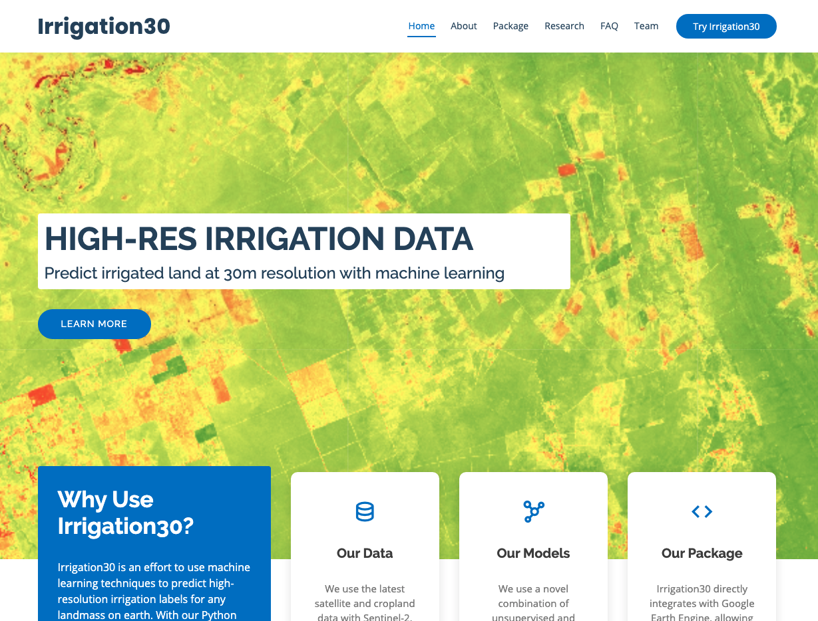
Website -
https://groups.ischool.berkeley.edu/irrigation30/
Notes:
WILL [0:09]
You can learn more about our project and our Python package on our website. The URL is listed here as well as Berkeley’s Capstone Summer 2020 website.
===

Slide 17
Backup
Notes:
WILL [10s]
And that concludes our presentation and we will open it up to Q&A
===

Slide 18
Model Evaluation #1: User Study
Conducted a user study with two environmental science researchers from Berkeley to help us get feedback about our model results and package design.
Compared two model versions:
“2-Cluster” design that assumes one irrigated and one rainfed cluster
NDVI/Precipitation heuristic model that labels irrigation for each cluster on a monthly basis
Takeaways:
Both models produced great results, but Model #2 is the best
Model #1 doesn’t detect multi-cropping well
Model #2 allows us to identify which months of the year that each cluster is irrigated
Notes:
Will [0:30]
For our first evaluation method, we conducted a user study with two environmental science researchers from Berkeley to help us get feedback about our model results and package design.
We set out to get feedback on two versions of our model using a small set of test cases that we curated from around the globe. The first model, called the “2-cluster” design, makes a major model assumption that will always label one cluster as irrigated and the other cluster as rainfed. The second model eliminates the need for this assumption, because this model labels irrigation for each cluster on a monthly basis using a heuristic with NDVI and precipitation.
Ultimately we had strong positive feedback for both models, although the second model, which ended up being our final model, showed the best results. One researcher noticed that the first model doesn’t detect multi-cropping very well, in other words, this model doesn’t help us detect when more than one crop is grown and irrigated at different times of year.

Slide 19
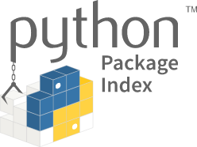
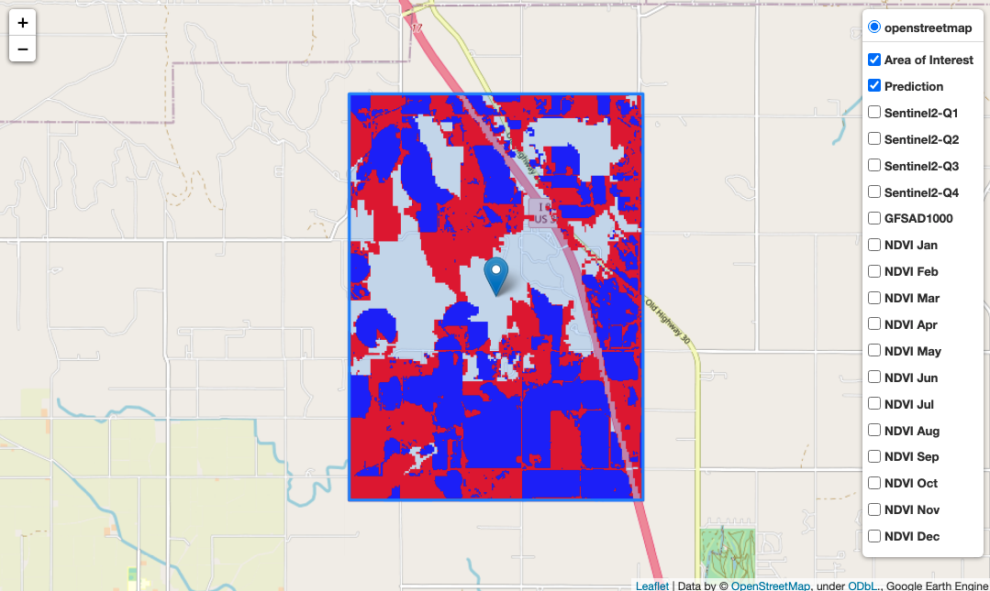
Our Deliverable → Python Package
irrigation30
Our Python package makes it easy for researchers to generate 30m-res irrigation inferences for small regions at a time using Google Earth Engine
Install with pip3 install irrigation30
>>> import irrigation30 as irr
>>> model = irr.Irrigation30(...)
>>> model.fit_predict()
>>> model.plot_map()
Notes:
WILL [0:30] → SHORTEN TO 15sec
Given the compute complexity of generating a global dataset of irrigation at our 30m resolution, we opted instead to create a Python package called “Irrigation30.” This Python package enables researchers to generate and visualize irrigation predictions at 30m resolution for small regions at a time using Google Earth Engine. We published this package to the Python Package Index, so anyone can simply install the package with pip in their terminal.
We’ll go over more details about what’s possible with this package and how to use it in our demo towards the end of the presentation.
===

Slide 20
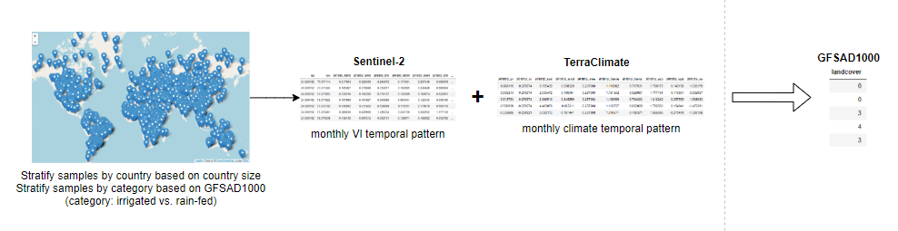
Modeling Pipeline - Supervised Algorithm
30m
4200m
1000m
Step 1: split the data into training and validation sets (will pull more data for test later)
Step 2: standardize features
Step 3: build models on the training set
Random forest
Gradient boost machine
LSTM
Logistic regression
Step 4: evaluate the model on the validation set
Notes:
ANGELA
In this slide, I will talk through the first approach of labeling the clusters, machine learning approach. In order for our model to be generalizable to the entire world, we have to sample the data globally. During the sampling process, we made sure our data was representative as well as balanced. We sampled data points by country and stratified it based on country size. We also stratified based on the label so that we have approximately the same number of data points for irrigated and rainfed cropland. In the end, we got approximately 5k points for each category.
Then we pulled monthly NDVI data as well as monthly climate data and modeled them against the ground truth GFSAD1000. You may wonder why don’t we just use this approach to build the entire model and why do we even bother to do the clustering first. This is because our data sources have inconsistent resolution as Matt and Adam mentioned earlier.
Despite this limitation, we still wanted to test whether we could get any value out of this model, such as whether we are able to label clusters using this method.
The rest of our supervised modelling is fairly standard. Basically, we split the data, standardize the features, build the models on the training set and evaluate them on the validation set. We plan to sample more data for the test set.
The four model types we tried are Random Forest, GBM, LSTM, and Logistic Regression. Most of these models had validation accuracy of 70%.

Slide 21
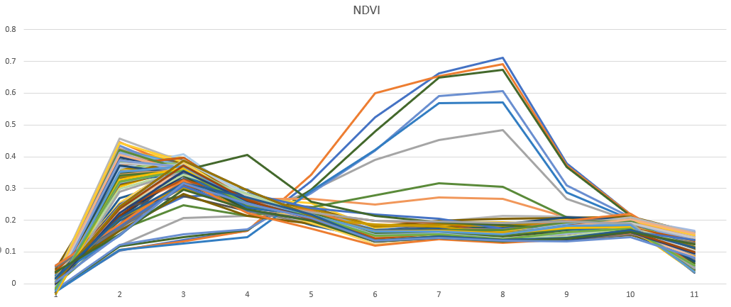
Why Clustering first?

Slide 22
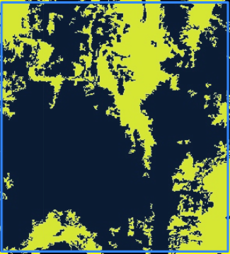
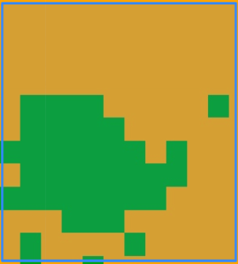
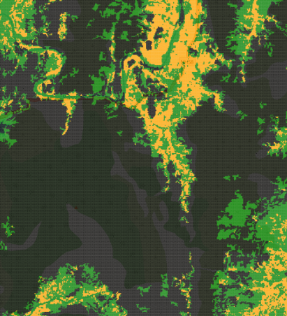
Modeling Pipeline - Result (using Similarity)
GFSAD30
GFSAD1000
Irrigation30
Black: non-cropland
Yellow: cropland
Black: non-cropland
Green: rainfed
Orange: irrigated
Black: non-cropland
Green: rainfed
Orange: irrigated
Notes:
ANGELA
For the test run of the pipeline on a 10 km by 10 km square in India, Similarity model is superior in labeling the clusters, and in this slide, I will show our final model output for the test run. We started with two images (GFSAD30 and GFSAD1000). One thing we discovered is that the two images are not consistent. The green area in GFSAD1000 here is labeled as rainfed cropland but is labeled as non-cropland in GFSAD30. Based on the satellite image, GFSAD30 is more accurate in this case.
Last but not least, I will show our final model prediction for this area at the 30 m resolution. Orange means irrigated and green means rainfed. Now I will turn it over to Matt to talk about model evaluation.

Slide 23
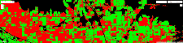
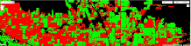
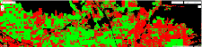
KMeans Training Sample Size Sensitivity Analysis
#Points
50k
5k
5
Significant improvement diminishes at 5k training samples. No change for 0.05, 0.1, 1.0 degree.

Slide 24
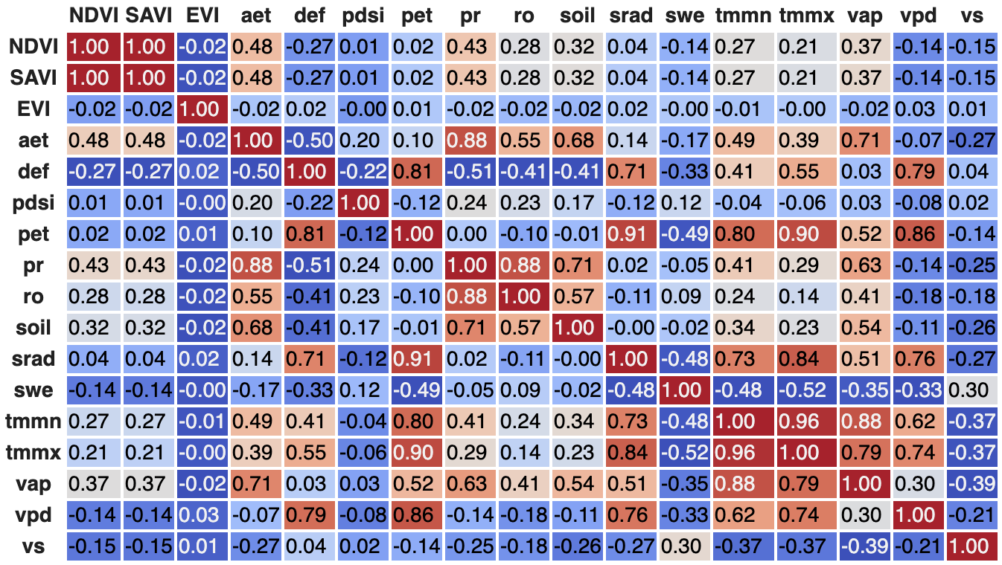
Correlation Heatmap
Notes:
Sonal [30sec]:
PCA done on the data shows features can be culled from 204 to 38. The above correlation heatmap for 2018 data shows that NDVI and SAVI are fully correlated. Hence we will use only NDVI index for analysis. EVI on the other hand is not highly correlated with either NDVI or SAVI nor any of the TerraClimate features. However prior research has shown NDVI and EVI produce equivalent classification results.
Of the rest of the features obtained from TerraClimate we are most interested in precipitation and max and min temperatures.

